Slide 1

CampusSwap: Online Marketplace for Students using Django
Prathamesh Mhatre (22106026)
Tejashri Maske (22106051)
Raj Nikam (22106027)
Hrishikesh Kharkar (22106002)
Project Guide
Ms. Sayali Badhan

Slide 2
Outline
Introduction
Literature Survey of the existing systems
Limitations of the existing systems
Problem statement
System Design
Technologies and methodologies
Implementation
Conclusion
References

Slide 3
Introduction
Welcome to the CampusSwap, a vibrant digital platform designed exclusively for the University community. this marketplace serves as a dynamic hub where students can buy, sell, and engage with a variety of products, services, and events tailored to their needs and interests.
Whether you're looking to declutter your dorm room by selling textbooks or furniture, searching for affordable options for course materials, or eager to promote your club's upcoming event to a wider audience, CampusSwap is your go-to destination.

Slide 4
Objectives
To encourage reuse and reduce waste
To connect students for potential collaboration
To offer affordable options for students
To ensure transparency through feedback

Slide 5
Literature Survey
[1] Mohd Fahmi Ismail, Maslina Abdul Aziz, Fatin Nur Syuhada Mohd Nor, Syaripah Ruzaini Syed Aris, Suzana Zambri. Student online marketplace for university community. The Indonesian Journal of Electrical Engineering and Computer Science (IJEECS) Vol 19, No 1 (2020)
The main problem faced by students either as the buyer or the seller is there is no business platform to promote their products or services. There is a lack of information regarding the business or services since most communications are done through instant messaging apps such as WhatsApp and social media. By having a student online marketplace, the exchange of goods and services take place by having buyers and sellers being in contact with one another.

Slide 6
Literature Survey
[2] Woolf, B.P., Lesser, V., Eliot, C., Eyler-Walker, Z., Klein, M. A Digital Marketplace for Education. In: Chin, W., Patricelli, F., Milutinović, V. (eds) Electronic Business and Education. Multimedia Systems and Applications Series, vol 20. Springer, Boston, MA. (2019)
This research introduces a student online marketplace tailored for university communities. It addresses the prevalent issue of students lacking a dedicated platform to promote their businesses effectively. By providing a centralized platform, it facilitates seamless exchanges.

Slide 7
Limitations
Building trust among users may take time, especially if there have been past experiences of fraud or unreliable sellers on similar platforms.
Advertising events can attract more users to the platform, including those who might not have otherwise visited. This increased traffic can lead to higher visibility for listings and greater participation in buying and selling activities.
No integration of the website with already existing student database.

Slide 8
Problem statement
To develop a comprehensive solution to facilitate the exchange of pre-owned items among students, promote affordability, sustainability, and foster community engagement within university campuses.

Slide 9
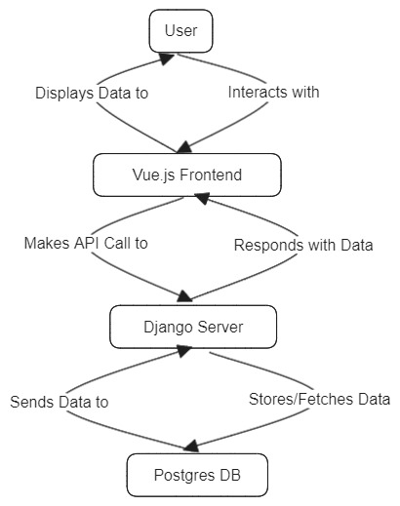
Fig. Data Flow Diagram

Slide 10
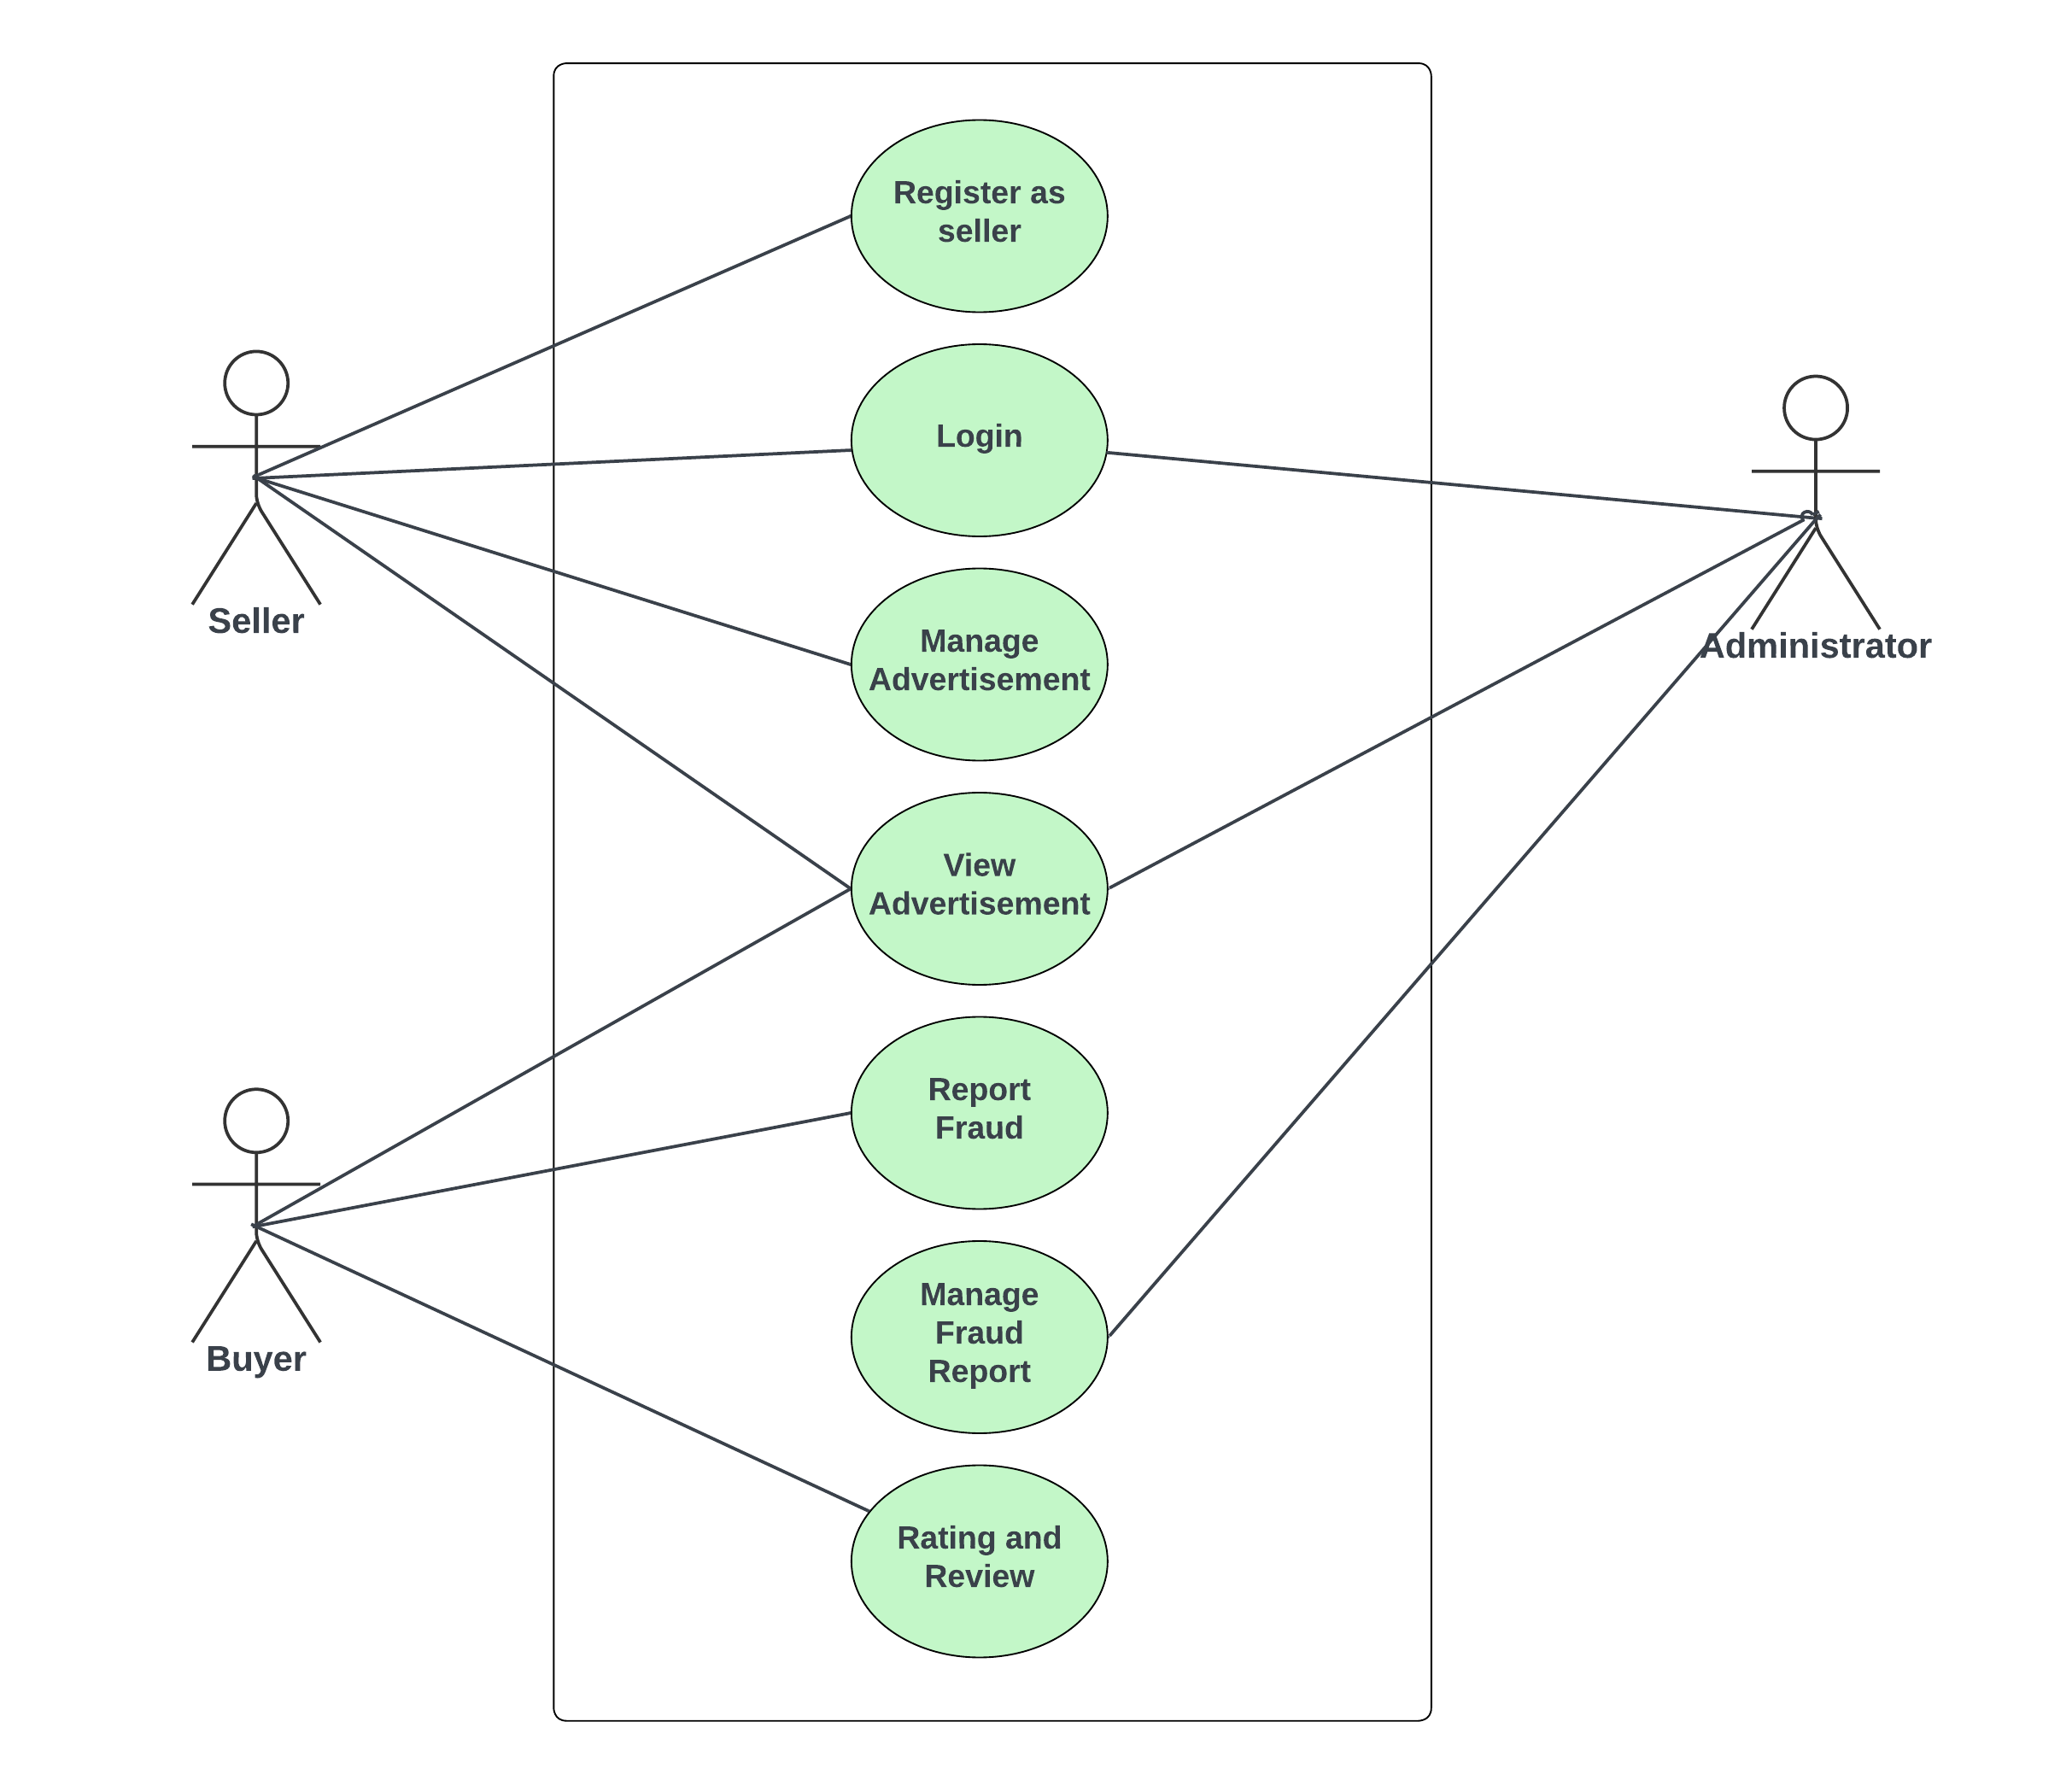
Fig. Use Case Diagram

Slide 11
Technologies
HTML
CSS
VUEJS
PRIMEVUE
DJANGO
POSTGRESQL

Slide 12
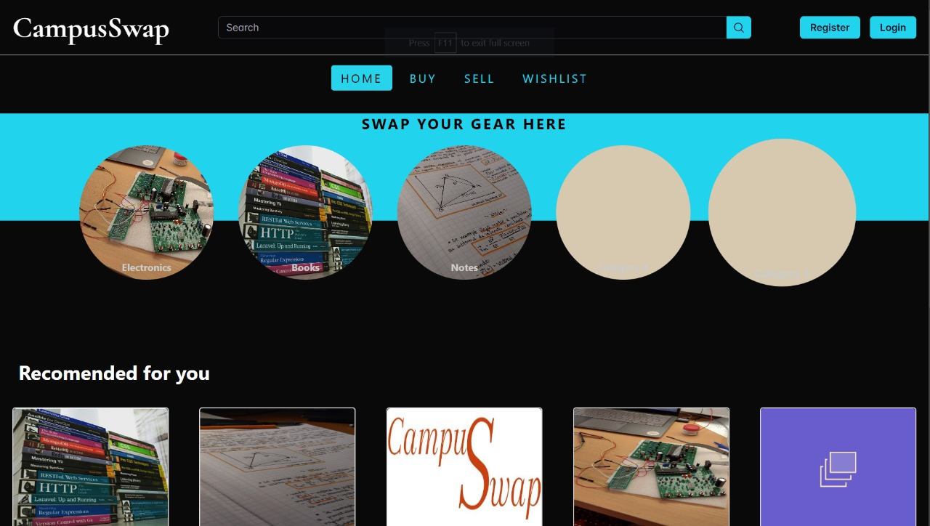
Implementation

Slide 13
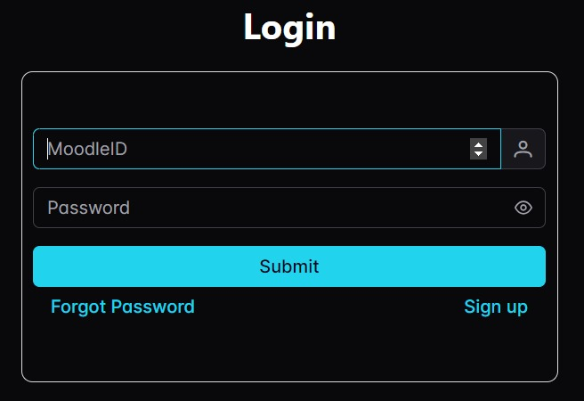
Implementation

Slide 14
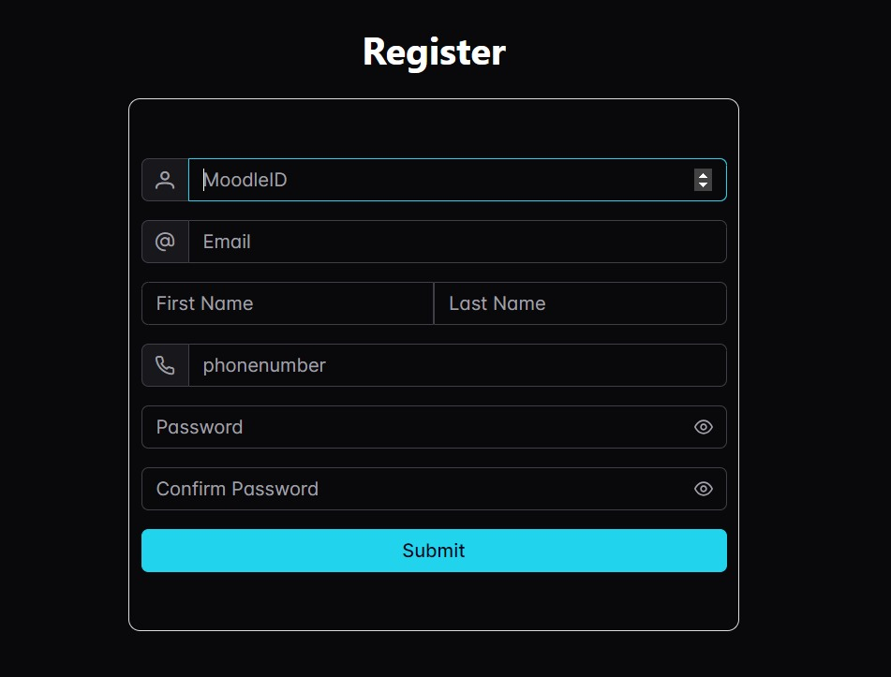
Implementation

Slide 15
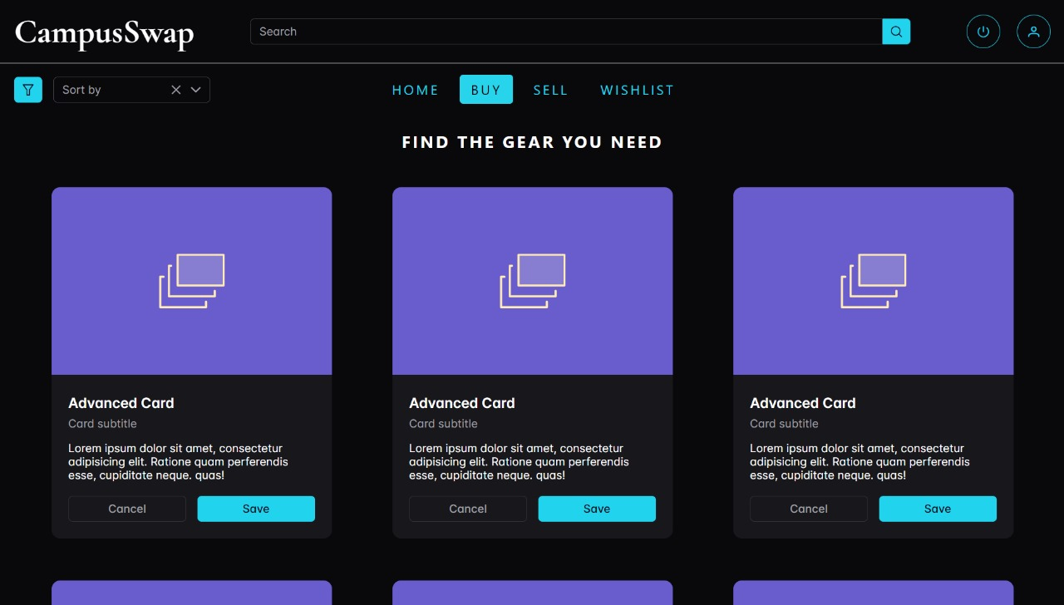
Implementation

Slide 16
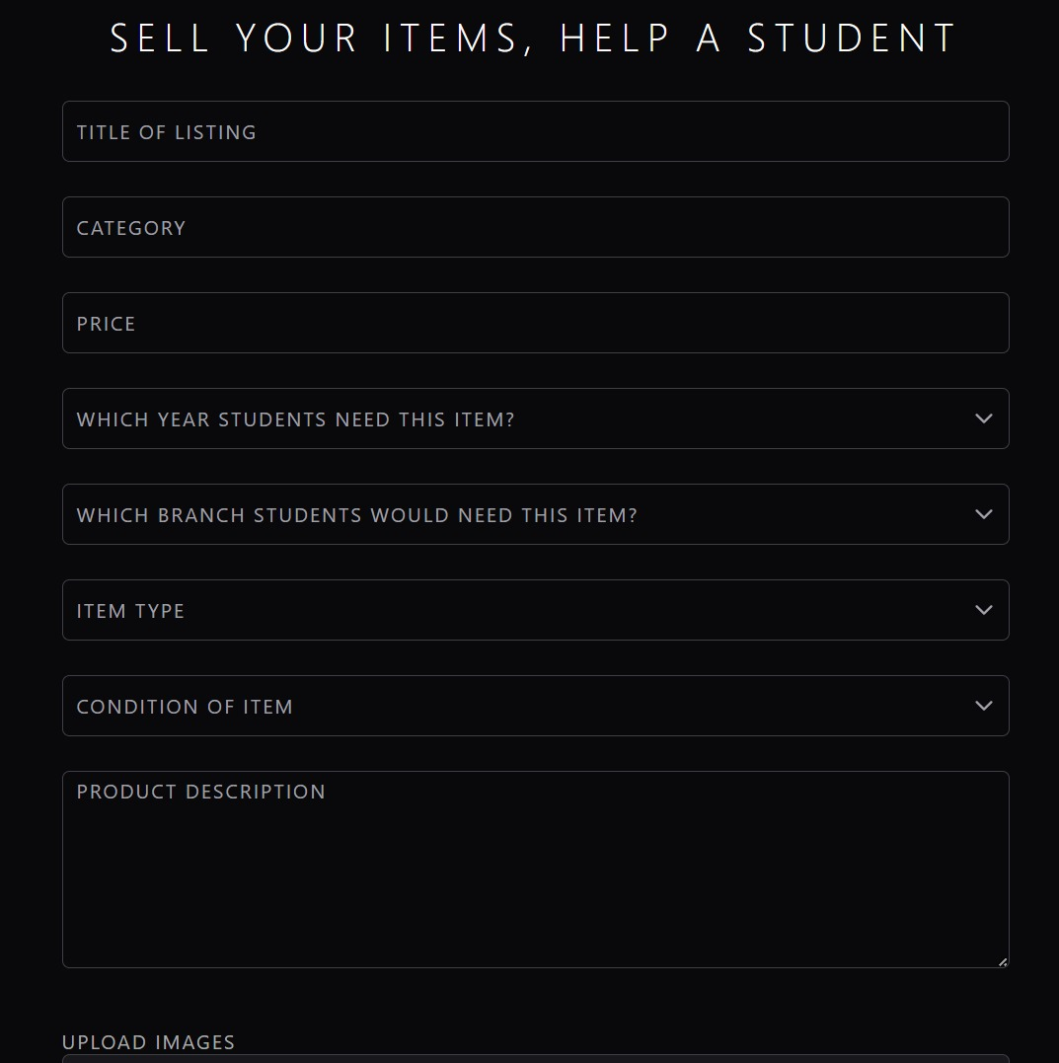
Implementation

Slide 17
Conclusion
The establishment of CampusSwap holds immense promise in addressing the challenges faced by university students. By providing a platform for the exchange of pre-owned items, promoting affordability, sustainability, and community engagement, this initiative has the potential to significantly enhance the university experience. Through collaboration and innovation, a vibrant online marketplace that not only meets the needs of students but also cultivates a culture of resourcefulness, financial responsibility, and support within our academic communities has been partially developed.

Slide 18
References
[1] Mohd Fahmi Ismail, Maslina Abdul Aziz, Fatin Nur Syuhada Mohd Nor, Syaripah Ruzaini Syed Aris, Suzana Zambri. Student online marketplace for university community. The Indonesian Journal of Electrical Engineering and Computer Science (IJEECS) Vol 19, No 1 (2020)
http://doi.org/10.11591/ijeecs.v19.i1.pp420-427
[2] Woolf, B.P., Lesser, V., Eliot, C., Eyler-Walker, Z., Klein, M. A Digital Marketplace for Education. In: Chin, W., Patricelli, F., Milutinović, V. (eds) Electronic Business and Education. Multimedia Systems and Applications Series, vol 20. Springer, Boston, MA. (2019)
https://doi.org/10.1007/978-1-4615-1497-8_1

Slide 19
Thank You!

